Slide 1
Logistic regression for categorical outcomes
蒋智超
2025年 秋

Slide 2
Categorical outcomes
Binary
Nominal: unordered categories
Marital status: single/married/divorced
Sector: service/agricultural/industrial
Ordinal: ordered categories but non-uniform interval
Service responses: strongly argree/agree/neutral/disagree/strongly disagree
Income: low/medium/high

Slide 3
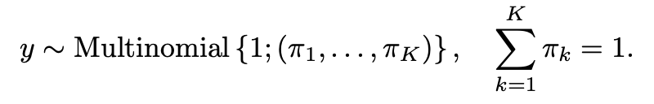
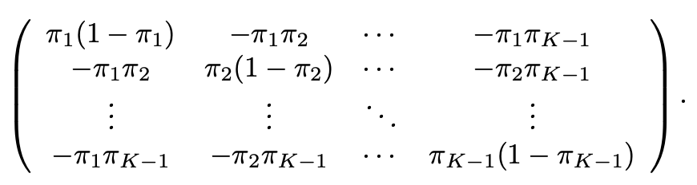

Multinomial distribution
Multinomial distribution
$y$ takes values in $\{1,…,K\}$with probabilities pr$(y=k)=π_{k}$
$(I(y=1) ,…, I(y=K−1))$ has mean ($π_{1},…,π_{K−1}$) and covariance matrix

Slide 4
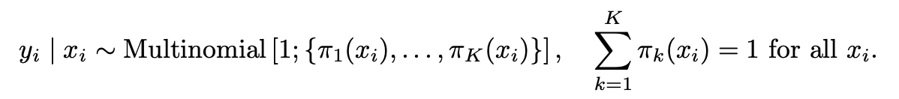
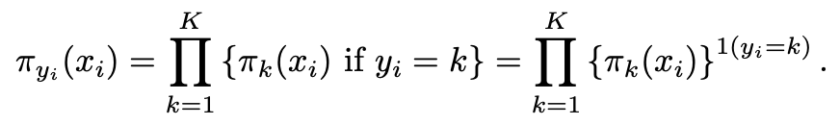

Multinomial distribution
We want to model $y_{i}$ based on covariates $x_{i}$
We will discuss canonical choices of $π_{k}(x)$ for nominal and ordinal outcomes

Slide 5
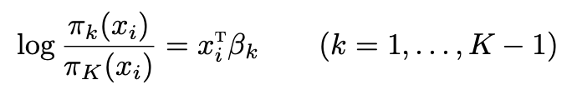

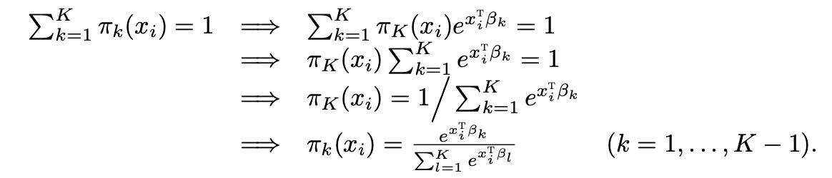

Multinomial logistic model for nominal outcomes
View category $K$ as the reference level, we model the ratios of the probabilities of category $k$ and $K$
Due to the normalization

Slide 6
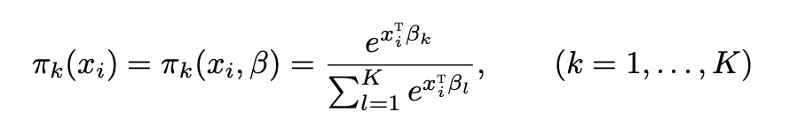


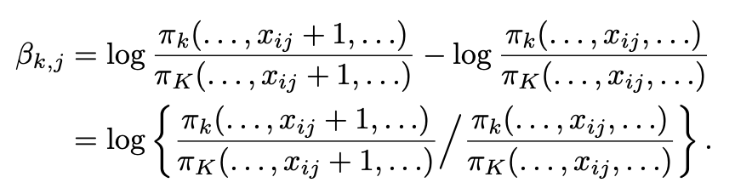
Multinomial logistic model for nominal outcomes
Interpretation: Conditional odds ratio compared to the reference level

Slide 7
A case study
A small observational dataset from the Karolinska Institute in Stockholm
Question of interest: whether it is better for cardia cancer patients to be treated in
high or small volume hospital, where volume is defined as the number of patients
with cardia cancer treated in recent years
Variables
Hightreat: whether a patient is treated at a high volume hospital
Age, rural, male
Survival: years of survival after diagnosis with three categories (1,2-4,5+)

Slide 8
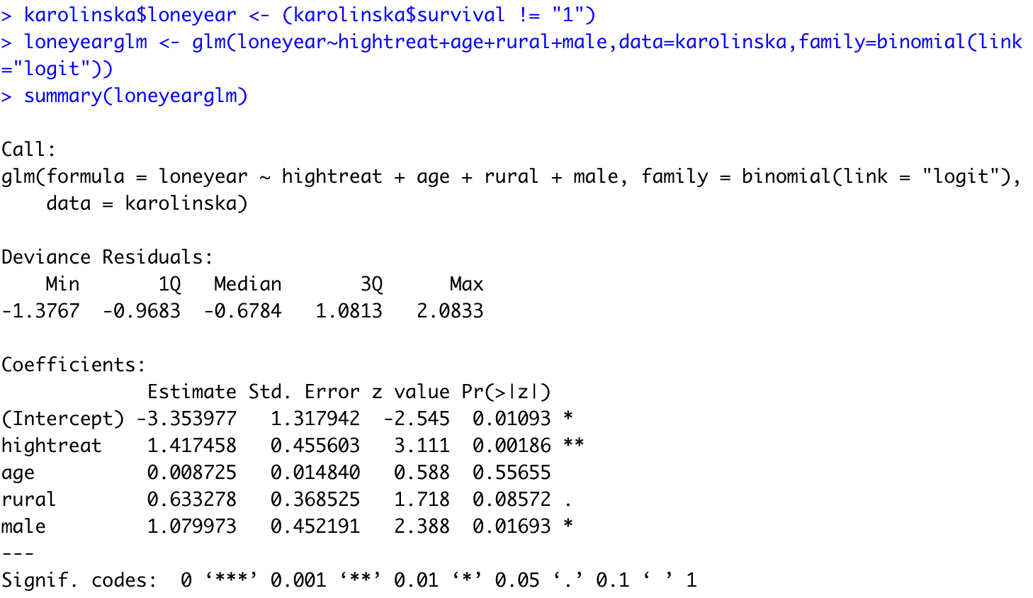
Binary logistic regression for the outcome

Slide 9
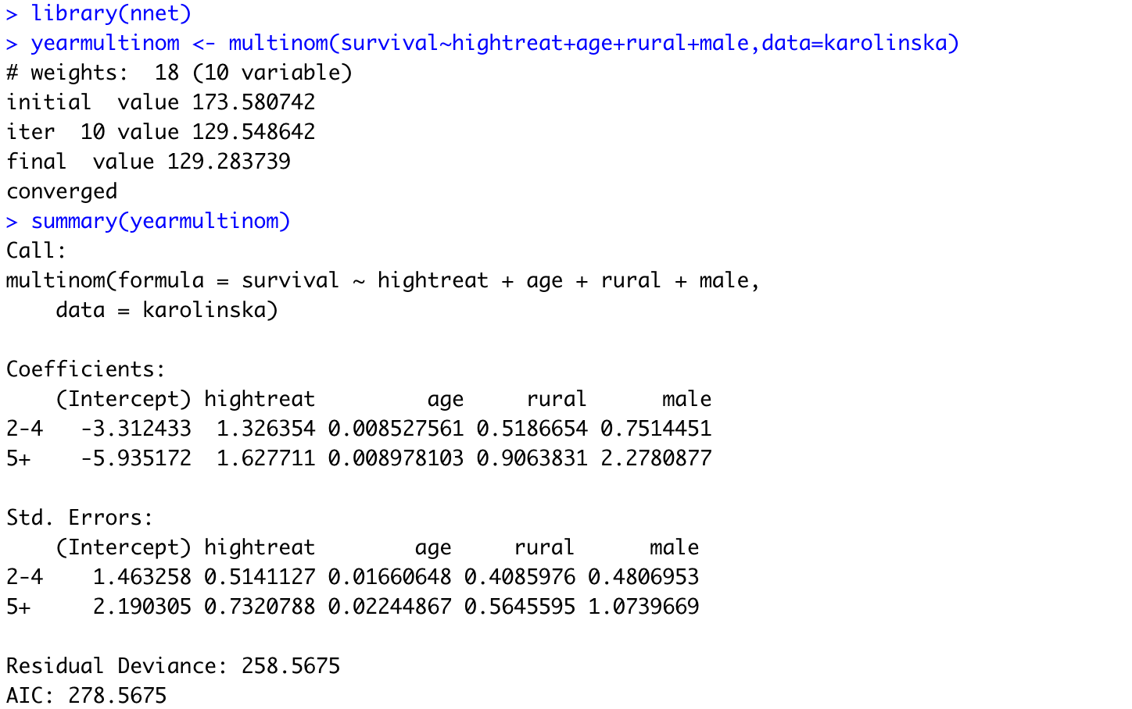
Multinomial logistic regression for the outcome

Slide 10

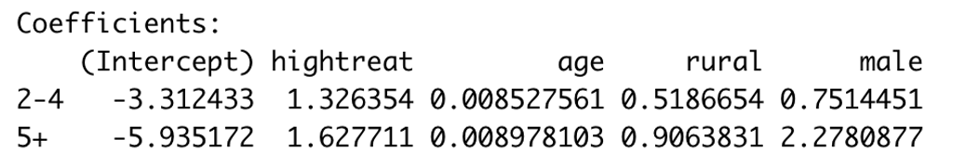
多选题
1分
For the coefficient of hightreat for the category 5+, which of the following interpretations are correct?
A
High-threat patients have a 1.6277 higher probability of surviving 5+ years.
B
The probability of 5+ year survival increases by 1.6277 when a tumor is high-threat rather than low-threat.
C
The coefficient shows that high-threat tumors significantly decrease the likelihood of short-term survival (0–1 years)
D
High-treat individuals are more likely to survive 5+ years than 0–1 years, with odds increased by a factor of exp(1.6277) compared to low-threat individuals.
提交

Slide 11
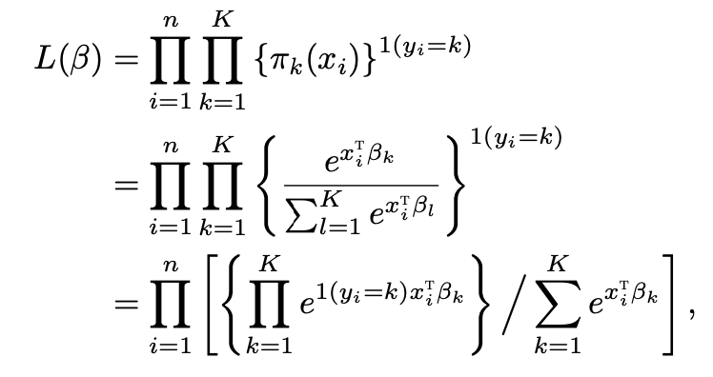
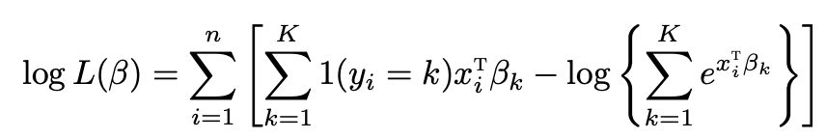
MLE
Likelihood function
Log likelihood

Slide 12
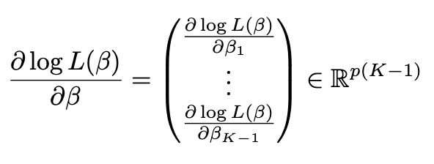
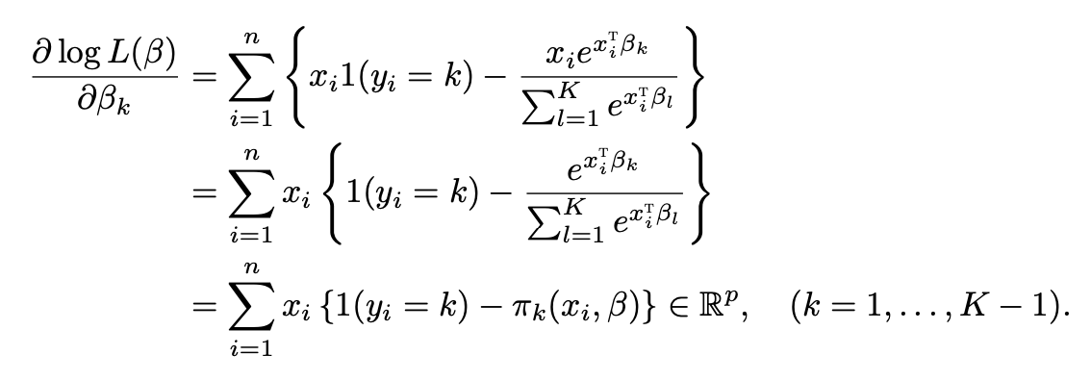


MLE
Score function
We can verify that the Hessian matrix is negative semi-definite
The function multinom in the nnet package uses Newton’s method to fit the multinomial
logistic model
For a new observation with covariate $x_{0}$, we can make prediction based on the fitted probabilities
$π_{k}(x_{0},\hat{β})$, and further classify it into the K categories based on

Slide 13
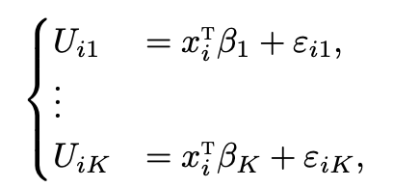
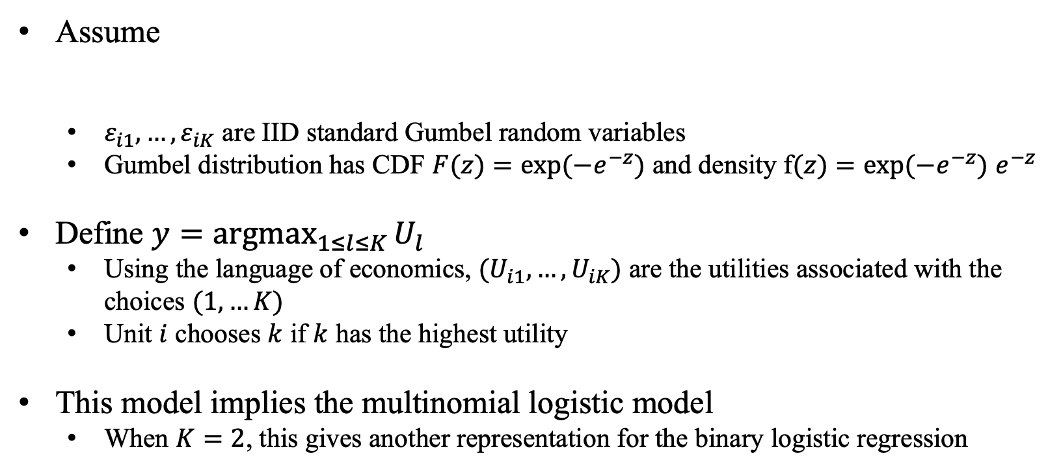
A latent variable representation
Assume
$ε_{i1},…,ε_{iK}$ are IID standard Gumbel random variables
Gumbel distribution has CDF $F(z)=exp⁡(−e^{−z})$ and density f$(z)=exp⁡(−e^{−z})$ $e^{−z}$
Define $y=\underset{1≤l≤K}{argmax}{U_{l}}$
Using the language of economics, $(U_{i1},…,U_{iK})$ are the utilities associated with the choices $(1,…K)$
Unit $i$ chooses $k$ if $k$ has the highest utility
This model implies the multinomial logistic model
When $K=2$, this gives another representation for the binary logistic regression

Slide 14
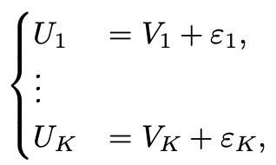

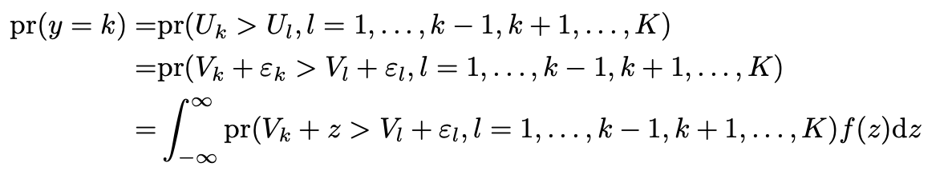
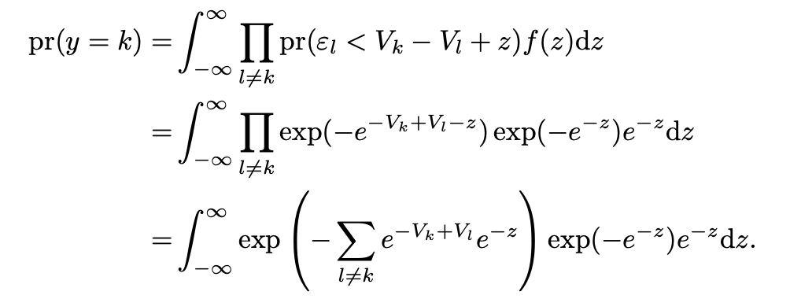
A latent variable representation
Proof:

Slide 15
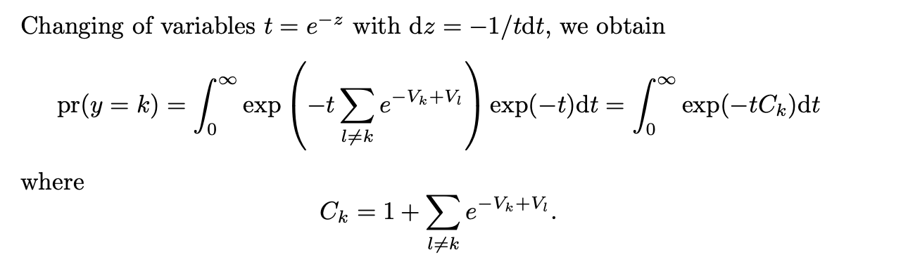
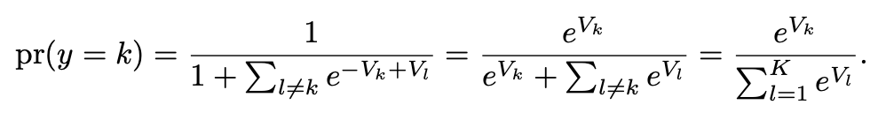
A latent variable representation

Slide 16
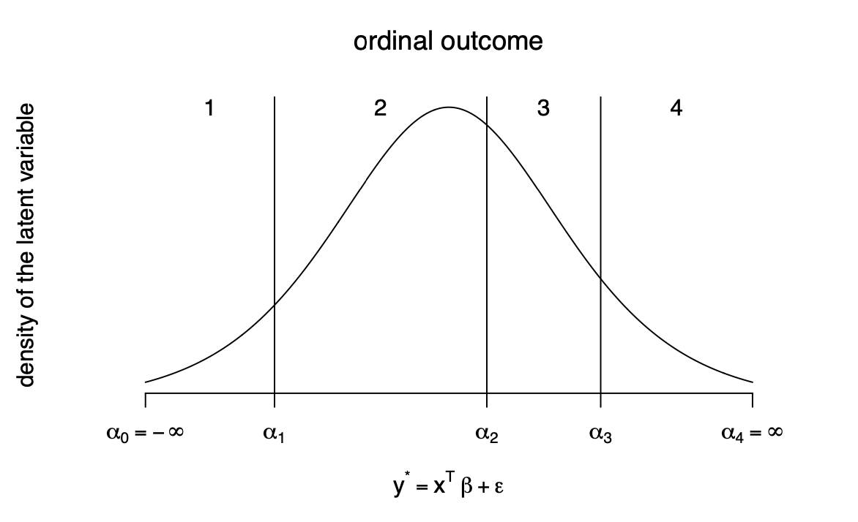
Proportional odds model for ordinal outcomes
For ordinal outcomes, we can still use the multinomial logistic model, but by doing this, we discard the ordering information in the outcome
We assume that the ordinal outcome arises from discretizing a continuous latent variable

Slide 17

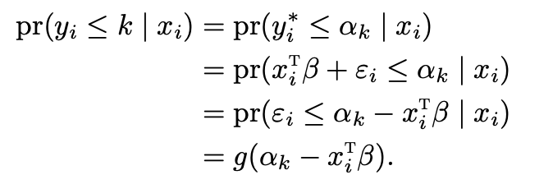
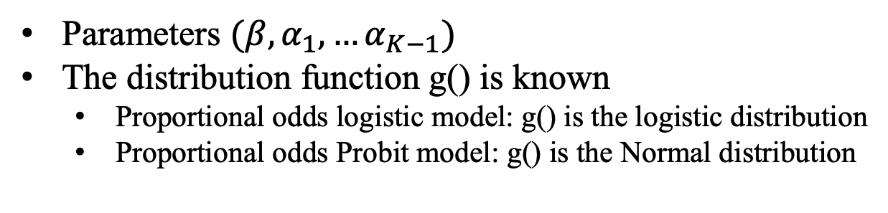
Proportional odds model for ordinal outcomes
Parameters $(β,α_{1},…α_{K−1})$
The distribution function g() is known
Proportional odds logistic model: g() is the logistic distribution
Proportional odds Probit model: g() is the Normal distribution

Slide 18
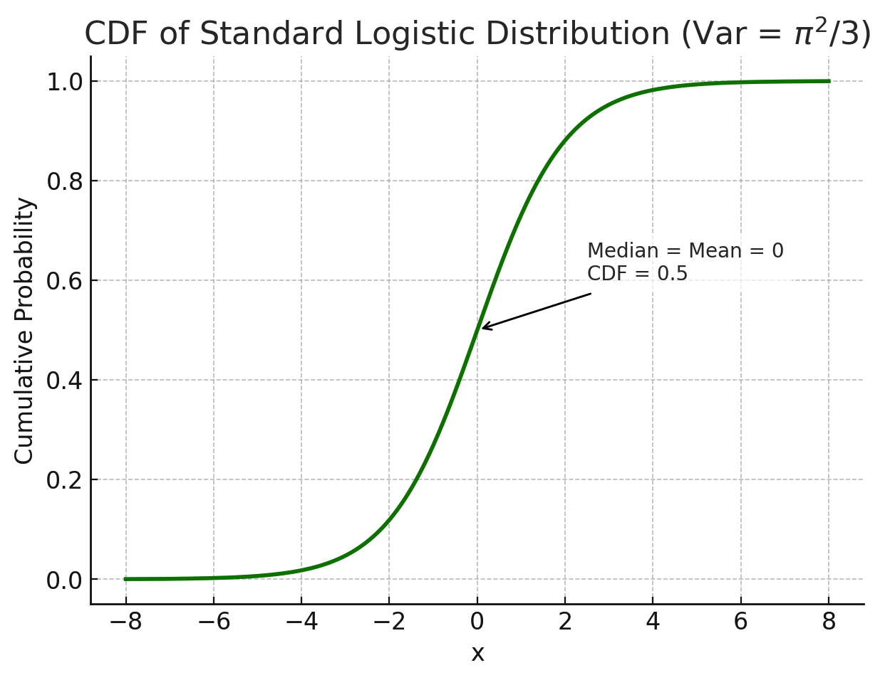
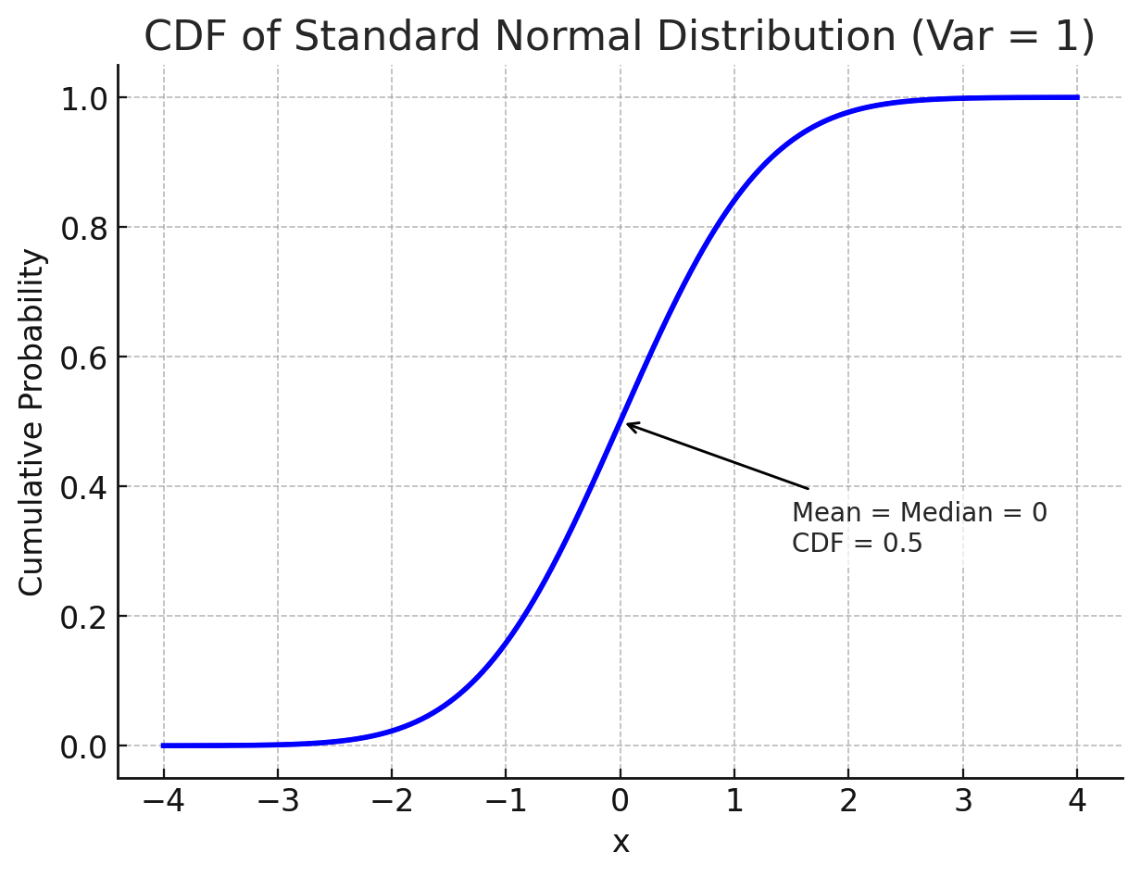






Proportional odds logistic/Probit model
logistic
Probit
$${F(α}_{l}−x_{i}^{T}β)$$
$${F(α}_{l}−x_{i}^{T}β)$$
$${F(α}_{l−1}−x_{i}^{T}β)$$
$${F(α}_{l−1}−x_{i}^{T}β)$$
$$ε$$
$$ε$$

Slide 19
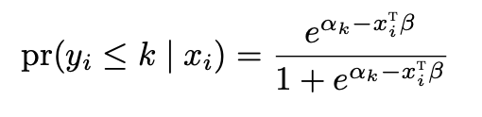
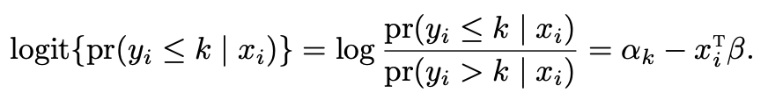
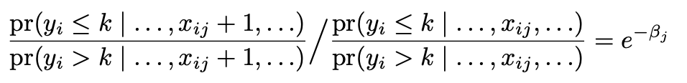
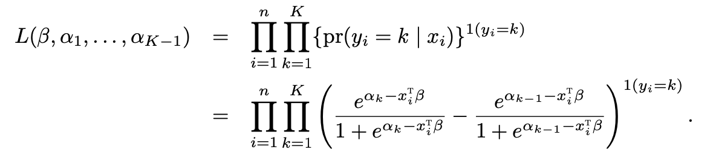
Proportional odds logistic model
Proportional odds property
Likelihood function
The function polr in the MASS package computes the MLE using the BFGS algorithm
Notes:
The sign of xi^t β is negative due to the latent variable representation. Some textbooks and software packages use a positive sign, but the function polr in package MASS of R uses a negative sign.

Slide 20

Proportional odds logistic vs. logistic
For each $k=1,…,K−1$
The Proportional odds logistic is equivalent to $K−1$ logistic regressions
logistic regressions with binary outcome $I(y≤k)$
Force all the logistic regressions to have the same slope

Slide 21
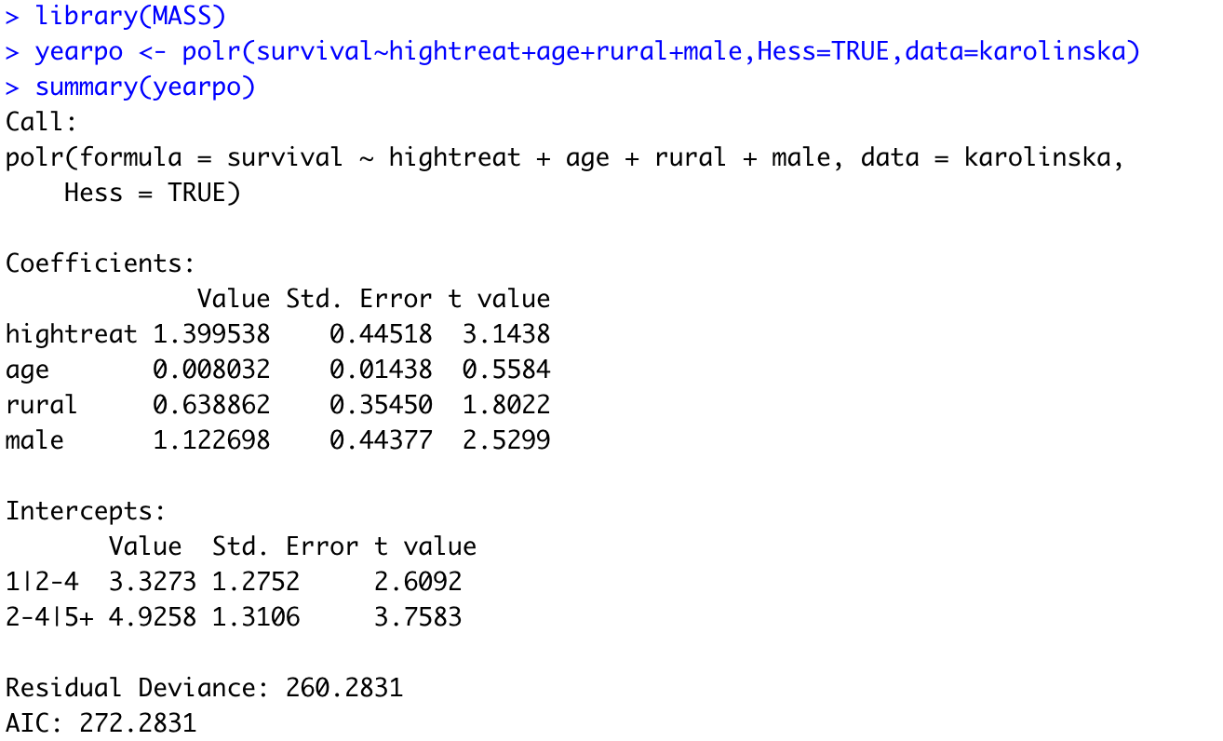
Proportional odds logistic for the outcome

Slide 22
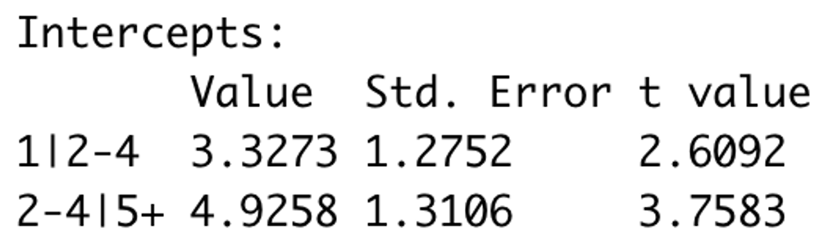
多选题
1分
Which of the following are correct for the intercept 1|2-4?
此题未设置答案，请点击右侧设置按钮
A
The predicted probability of being in category 2–4 versus 1 when all predictors are 0.
B
The log-odds of being in category 1 versus category 2–4 or higher, when all predictors are 0.
C
The difference in the predicted probabilities between categories 1 and 2–4.
D
The odds ratio of being in category 2–4 versus 5+ when all predictors are at their mean.
提交

Slide 23
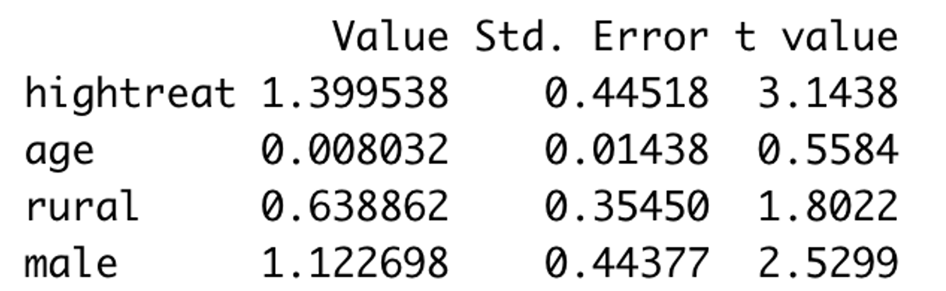
多选题
1分
Which of the following are correct for the slop 1.40?
A
High treatment changes the odds of being in a higher survival category by a factor of exp(1.4), holding other covariates constant.
B
High treatment changes the odds of being in a higher survival category by a factor of exp(-1.4), holding other covariates constant.
C
Individuals in the high-treat group have 1.4 times higher probability of being in the highest survival category, compared to those in the low-treat group
D
The odds of being in any specific category (e.g., “2–4”) are multiplied by exp(1.4) if the individual is in the high treatment group.
提交

Slide 24
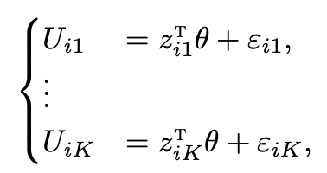
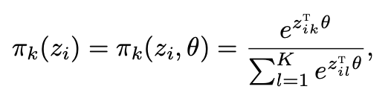
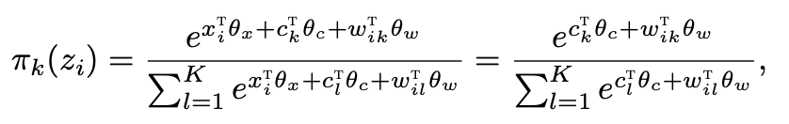
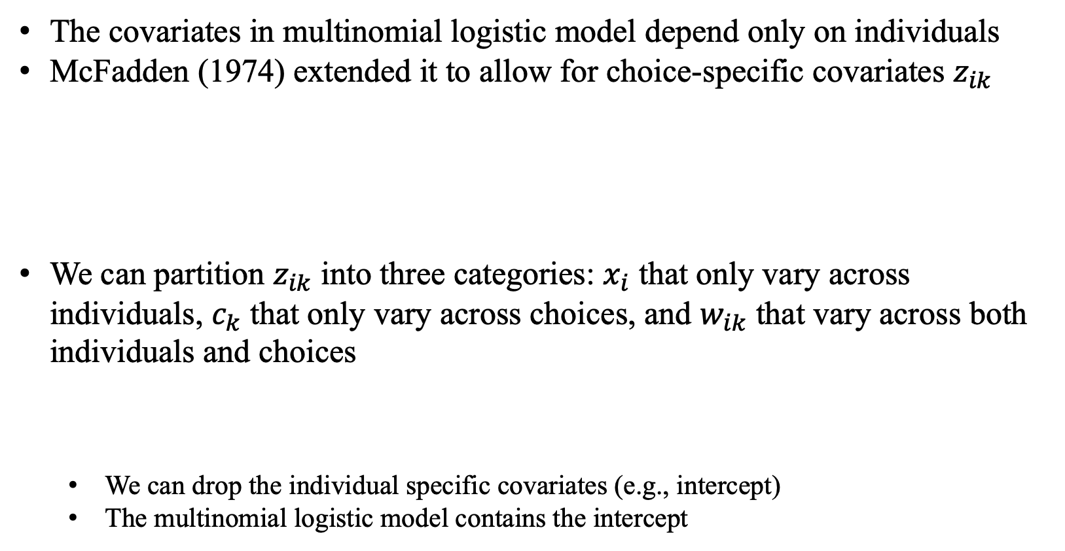
Discrete choice model
The covariates in multinomial logistic model depend only on individuals
McFadden (1974) extended it to allow for choice-specific covariates $z_{ik}$
We can partition $z_{ik}$ into three categories: $x_{i}$ that only vary across individuals, $c_{k}$ that only vary across choices, and $w_{ik}$ that vary across both individuals and choices
We can drop the individual specific covariates (e.g., intercept)
The multinomial logistic model contains the intercept

Slide 25
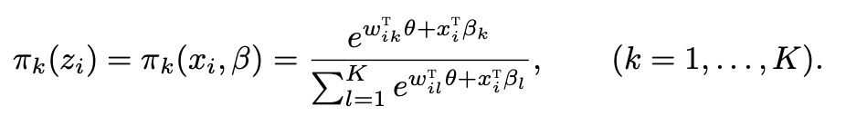
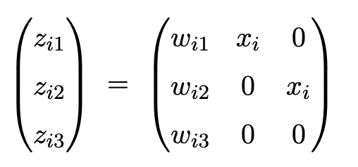
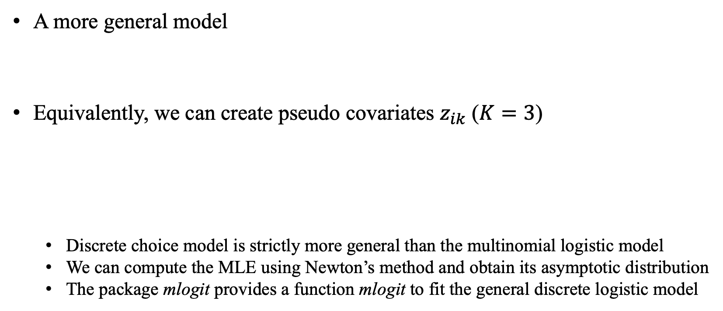
Discrete choice model
A more general model
Equivalently, we can create pseudo covariates $z_{ik}$ ($K=3$)
Discrete choice model is strictly more general than the multinomial logistic model
We can compute the MLE using Newton’s method and obtain its asymptotic distribution
The package mlogit provides a function mlogit to fit the general discrete logistic model

Slide 26
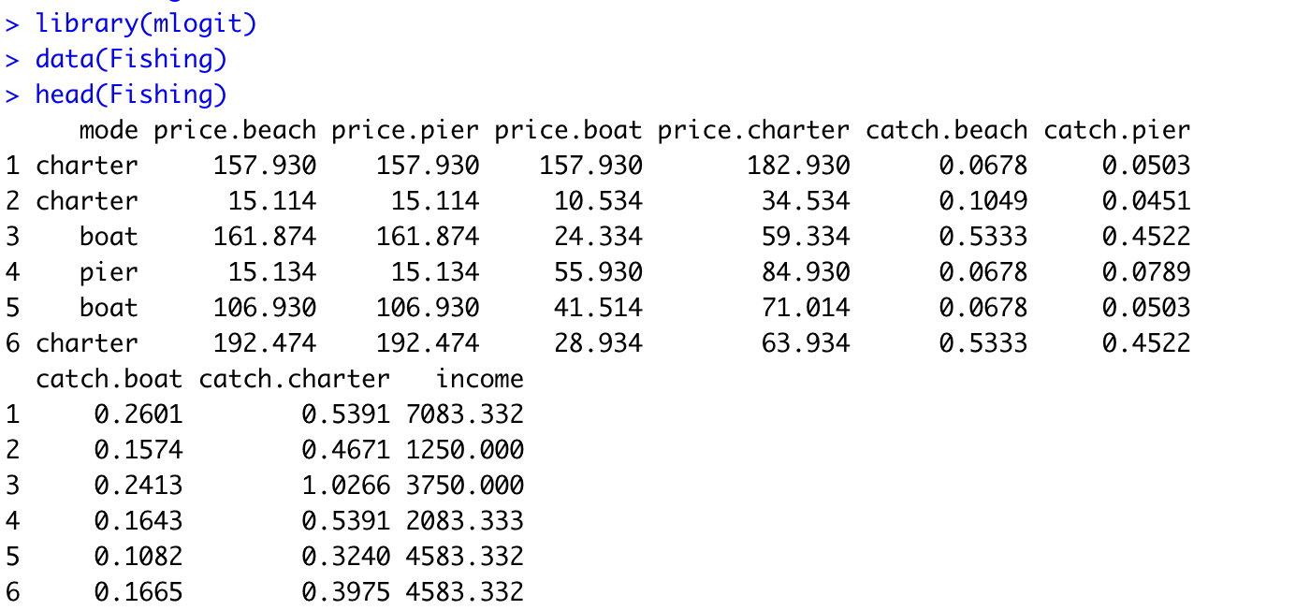
Fishing data

Slide 27
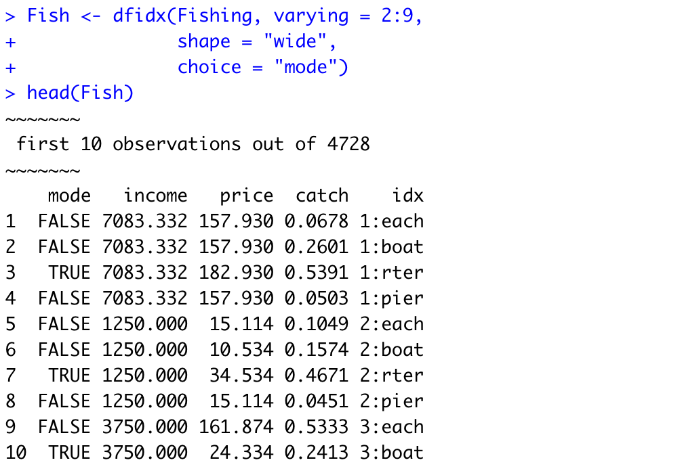
Fishing data
Notes:
price and catch denote the price and catching rates

Slide 28
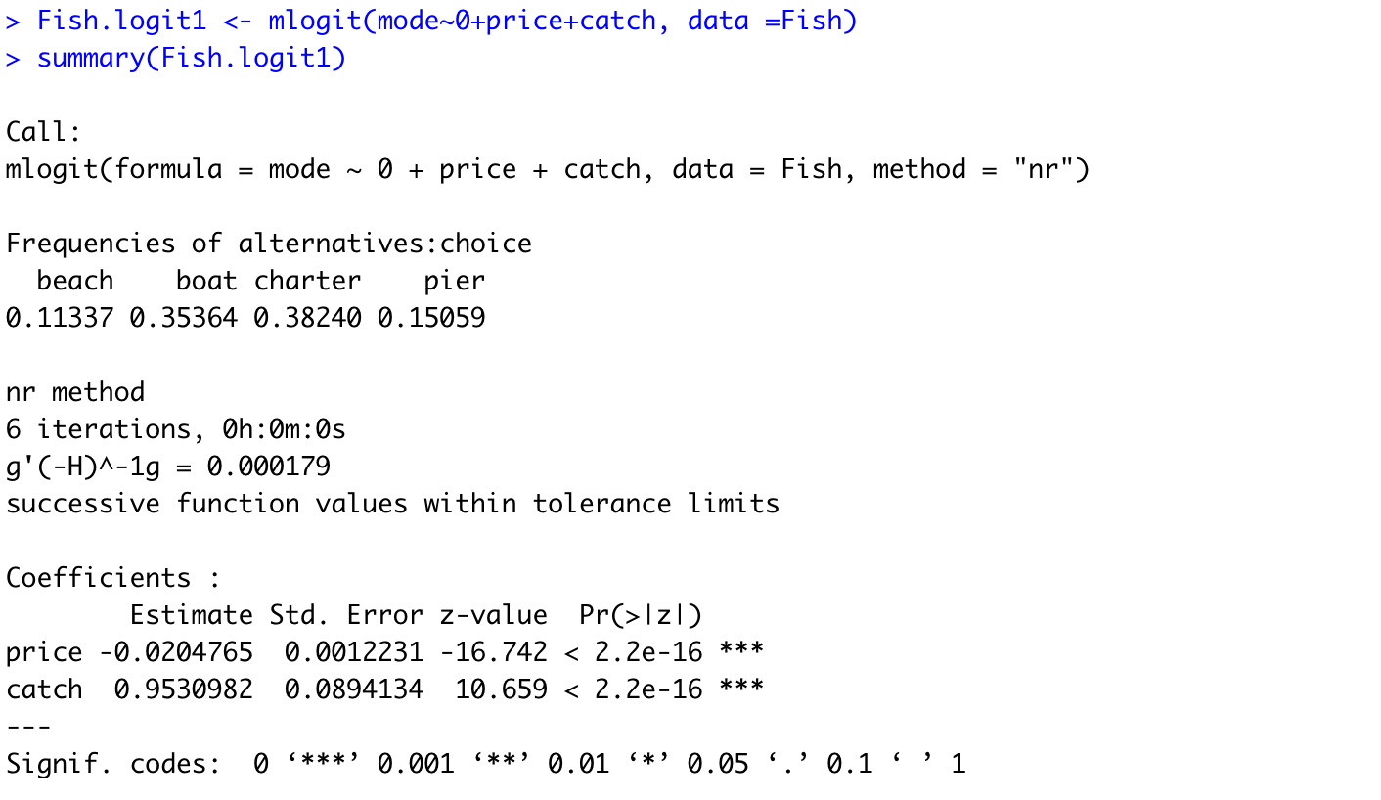
Fishing data
Using only choice-specific covariates

Slide 29
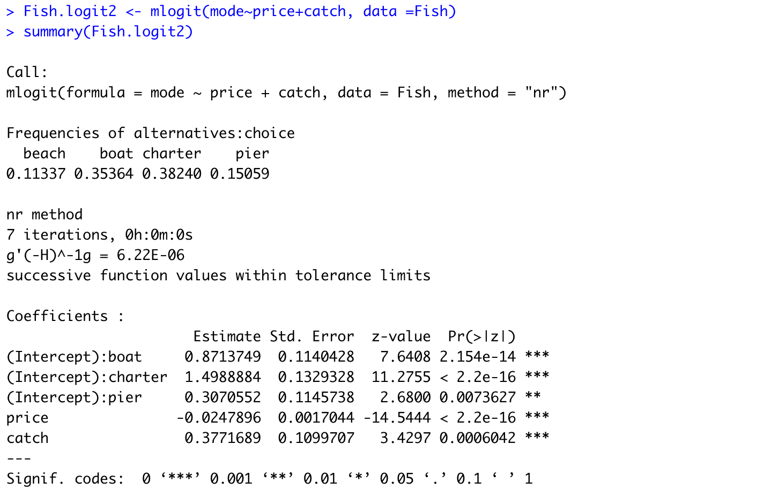
Fishing data
If we do not enforce 0+ in the formula, then we allow for intercepts that vary across choices

Slide 30

Fishing data
Using only individual-specific covariates

Slide 31

Fishing data
The most general model includes all covariates

Slide 32


Comments
The assumption of Gumbel error terms is very strong
Relaxing this assumption leads to much more complicated forms of the conditional probabilities of the outcome
The discrete choice model implies
Independence of irrelevant alternatives (IIA) assumption: choice between $k$ and $l$ does not depend on the existence of other choices

